Slide 1
Network Automation

Slide 2

Network Automation Concept
It's the utilization of technologies and tools
to enhance the operation
and management of networks
in a more efficient and accurate manner
achieved through programming
artificial intelligenc and
automated control.

Slide 3
Benefits of Network Automation
Increased efficiency and reduced human errors.
Accelerated network responsiveness to business needs.
Flexibility in configuring and managing networks.
Improved security and monitoring through automated control and data analytics

Slide 4
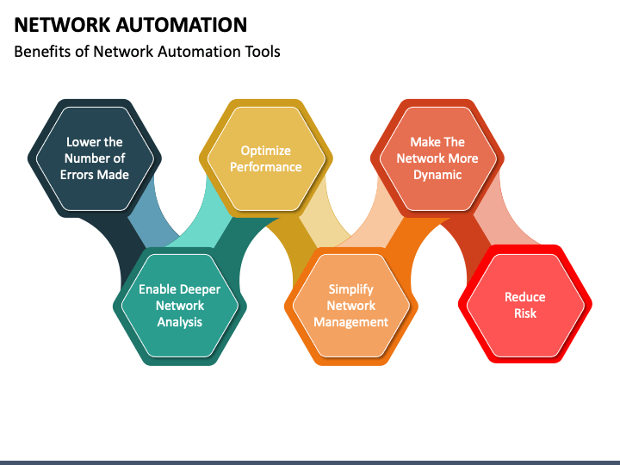
Benefits of Network Automation

Slide 5
Data Formats in Network Automation
Data formats play a crucial role in network automation, representing how data is encoded and organized for transmission between devices and systems across the network. These formats significantly impact the interaction and communication among network components and the exchange of information between them.

Slide 6
Types of Data Formats
JSON (JavaScript Object Notation): Among the most commonly used data formats in network automation, known for its ease of readability and writing, facilitating data exchange between different systems.
XML (Extensible Markup Language): Another data format used to organize and exchange data between network components, providing great flexibility in data representation.
YAML (YAML Ain't Markup Language): A simple, human-readable data format used for data representation and exchange between various network devices and applications.

Slide 7
Data Format Rules
In network automation, data formatting rules play a vital role in organizing the structure of data and representing it in a recognized and proper manner. Some fundamental syntax rules for data formatting in this context include.
These basic rules help in accurately representing and comprehending data within the automation network, facilitating its exchange and usage among various components and systems within the network infrastructure.

Slide 8
Compare Data Formats
XML Syntax Rules
JSON Syntax Rules
YAML Syntax Rules
- The usage of paired tags `<tag>...</tag>` to define elements is essential. - Elements should be correctly nested, with opening and closing tags for each element.
- Data should be written properly within braces `{}`. - Elements should be separated by commas, and names/values should be enclosed in quotation marks. - Data is represented in key-value pairs format: `"key": "value"`.
- Data can be represented using spaces and hierarchical arrangement. - Stars (*) and dashes (-) are used for lists. - Double colons (::) denote keys and values in the data.

Slide 9
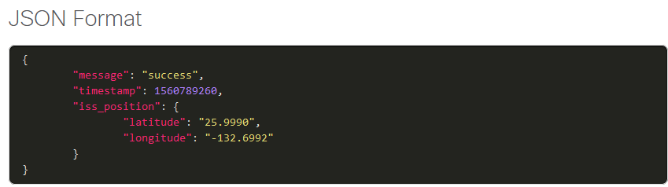
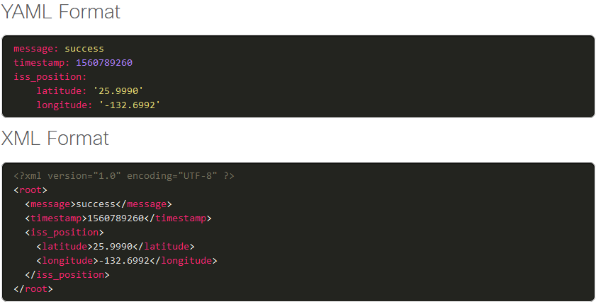
Compare Data Formats

Slide 10
The API Concept
Application Programming Interfaces (APIs) are a fundamental part of the modern technology landscape, allowing applications to communicate and interact seamlessly. These interfaces streamline processes and provide easy access to data and services, accelerating development processes and enhancing user experience. Additionally, APIs enable integration and compatibility between different applications and services, fostering better performance and efficiency for companies and systems.

Slide 11
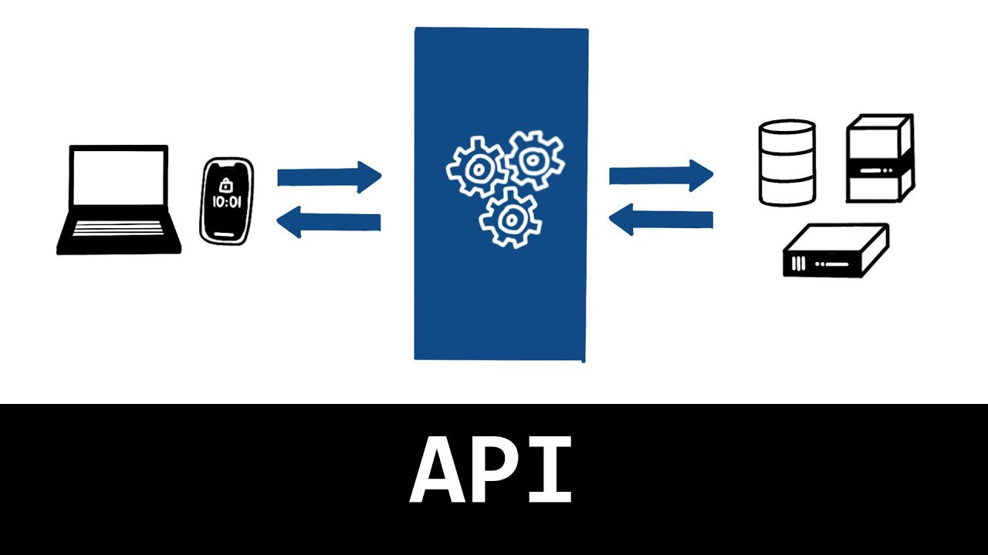
API Example

Slide 12
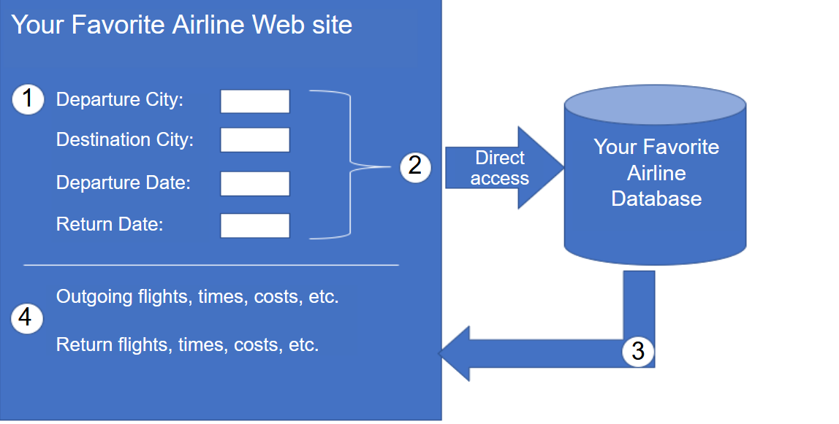
API Example

Slide 13
Types of Apis
Open APIs or Public APIs
Internal or Private APIs
Partner APIs
These APIs are publicly available and can be used with no restrictions. The International Space Station API is an example of a Public API. Because these APIs are public, many API providers, such as Google Maps, require the user to get a free key, or token, prior to using the API. This is to help control the number of API requests they receive and process. Search the internet for a list of public APIs.
These are APIs that are used by an organization or company to access data and services for internal use only. An example of an internal API is allowing authorized salespeople access to internal sales data on their mobile devices.
These are APIs that are used between a company and its business partners or contractors to facilitate business between them. The business partner must have a license or other form of permission to use the API. A travel service using an airline’s API is an example of a partner API.

Slide 14
Types of Web Service APIs
A web service is a service that is available over the internet, using the World Wide Web. There are four types of web service APIs:
Simple Object Access Protocol (SOAP)
Representational State Transfer (REST)
eXtensible Markup Language-Remote Procedure Call (XML-RPC)
JavaScript Object Notation-Remote Procedure Call (JSON-RPC)

Slide 15
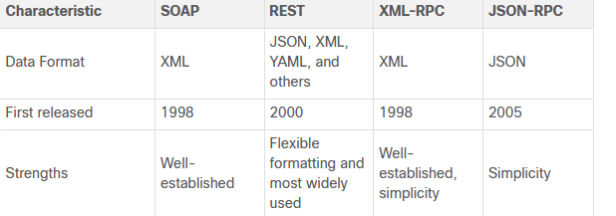
Types of Web Service APIs

